Slide 1



OPTIMIZATION OF CONCRETE MIX DESIGN USING GENETIC ALGORITHMS
B-TECH PROJECT - I
Submitted by
Islavath Mohan Naik
21CE31006
Under the supervision of
Dr. Amit Shaw

Slide 2








TABLE OF CONTENTS
01
Introduction
02
Literature Review
Overview of the project’s purpose and significance.
Summarizes relevant prior research
03
Methodology
04
Results
Explains the approach and techniques used.
Presents and evaluates findings
05
Conclusions
06
References
Summarizes the key findings and implications of the study
Lists all the academic and technical sources referenced in the project.

Slide 3
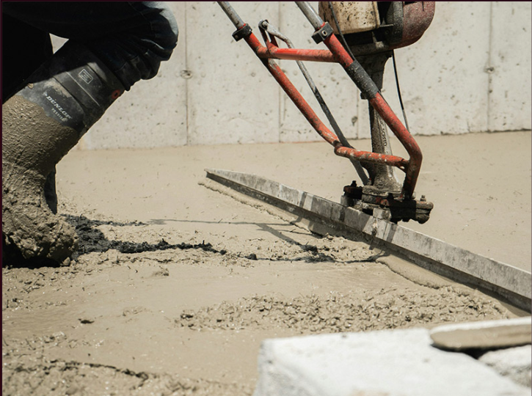
INTRODUCTION
Importance of Concrete: Concrete is the second most consumed material on Earth due to its flexibility, cost-efficiency, and adaptability in construction.
Concrete Mix Design: It is a critical step in construction, determining concrete quality, durability, and strength through precise material proportioning.
Optimization in Mix Design: Optimization techniques like Genetic Algorithms (GA) provide time-efficient and reliable solutions, reducing reliance on trial-and-error methods.
Role of Genetic Algorithm (GA): GA, inspired by natural selection, optimizes concrete parameters such as water-cement ratio, adhering to standards like IS 10262 and IS 456.
Abrams’ Water-Cement Law: Used in GA to find the optimal water-cement ratio and achieve desired concrete strength.
01

Slide 4

OBJECTIVE AND SCOPE
Study Objective: Develop optimized mixes for grades M20, M25, and M30 using GA to meet strength, workability, and durability standards while minimizing material costs.
Scope: Create a MATLAB-based code for automated mix design, offering a sustainable framework for computational optimization applicable to diverse grades and performance needs.
Outcomes: Ensures consistency, accuracy, cost-effectiveness, and sustainability in concrete mix design, enhancing construction quality and efficiency.

Slide 5





LITERATURE REVIEW
Enhanced Precision and Efficiency
Computational techniques like MATLAB, Genetic Algorithms (GAs), and Particle Swarm Optimization (PSO) significantly improve precision, reduce manual effort, and save time in concrete mix design.
Multi-Criteria Optimization:
Techniques like Pareto optimality and multi-criteria optimization address conflicting objectives such as cost minimization, strength maximization, and environmental considerations effectively
Optimized Mix Proportions
Tools such as GAs, PSO, and hybrid models have been successfully applied to derive optimal concrete mix proportions, achieving better performance in terms of strength, durability, cost, and workability
Integration of Emerging Techniques
Validation through Experimental Results
Recent research highlights the growing use of advanced soft computing techniques, such as ANN, Fuzzy Logic, and ANFIS, to predict and optimize concrete mix characteristics, offering adaptable and accurate solutions.
Studies demonstrated that computational models, including MATLAB programs and Artificial Neural Networks (ANNs), produce results closely matching experimental data, confirming their reliability
02

Slide 6
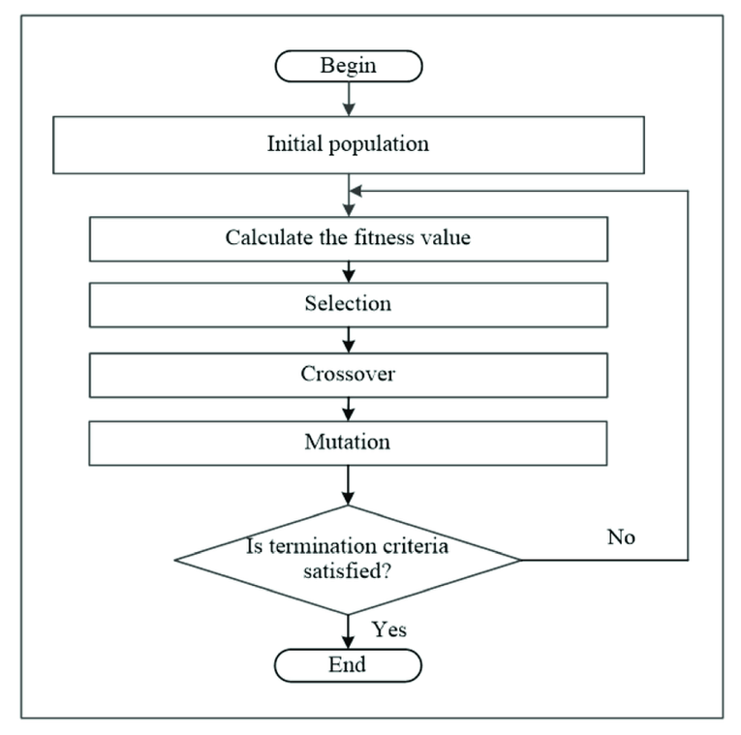
OVERVIEW OF GENETIC ALGORITHMS
What is a Genetic Algorithm (GA)?
Genetic Algorithm (GA) is an optimization technique inspired by the principles of natural selection and genetics.
It involves operations like selection, crossover, and mutation to find optimal or near-optimal solutions iteratively.
GAs are suitable for solving complex, multi-variable, and non-linear problems efficiently.
Why Use GA in Concrete Mix Design Optimization?
Efficiency: GA optimizes concrete mix designs faster and with fewer iterations compared to manual methods.
Cement Reduction: Reduces cement quantities, lowering costs and promoting sustainability.
Parameter Optimization: Considers multiple parameters (e.g., w/c ratio, aggregate proportions) simultaneously for optimal results.
High-Quality Mix: Ensures desired compressive strength, durability, and performance by accurately balancing materials.
Flexibility: Easily adapts to different design requirements, such as material availability and environmental constraints.
03

Slide 7
METHODOLOGY
Modeling the Function in GA-Based Concrete Mix Design
Fitness Function:
The fitness function represents the relationship between compressive strength (Y) and water-to-cement ratio (X), following Abrams’ law:
Y = -(a / b^(1.5 * X)),
where a=96.52 MPa and b=4
Constraints:
Linear Inequality Constraint: Ensures hydration starts when X≥0.23: 3.1X+0.23<0.
Minimum cement content, maximum w/c ratio based on IS standards
Hydration begins within a w/c ratio range of 0.22 to 0.25
GA Optimization:
Incorporates the fitness function and constraints to optimize the mix design.
Balances material efficiency and structural performance for economical, durable, and high-strength concrete.
Benefits:
Ensures functional and durability requirements are met.
Provides a systematic, modern tool for efficient civil engineering applications.
03

Slide 8
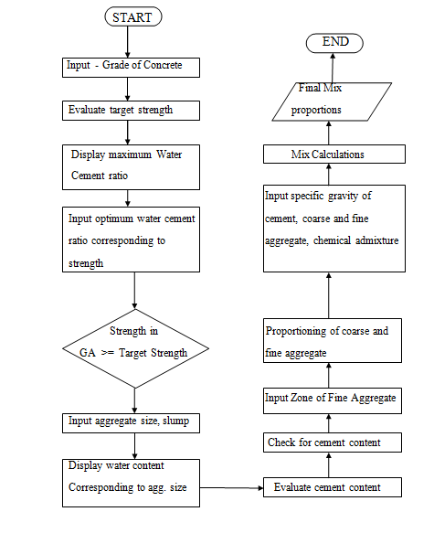
METHODOLOGY
1. Concrete Mix Design in MATLAB
(Based on BIS Method and IS 10262:2009)
1. Target Strength Calculation:
Formula: ts=fck+1.65×S,
where fck is characteristic strength and S is the standard deviation.
2. Maximum W/C Ratios:
M20: 0.55, M25: 0.50, M30: 0.45 (as per IS 10262:2009).
3. Optimization with GA:
A range of w/c ratios is optimized using GA, ensuring the obtained strength meets or exceeds the target strength.
4. Design Code Features:
Checks for minimum cement content and maximum w/c ratio.
Mix calculations are performed based on material parameters provided by the user.
5 .Execution in MATLAB:
Inputs (e.g., grade, standard deviation) are provided step-by-step in the command window.
Results are displayed in the command window, and variables are stored in the workspace for further analysis.
This procedure ensures an efficient, accurate, and standards-compliant concrete mix design.

Slide 9
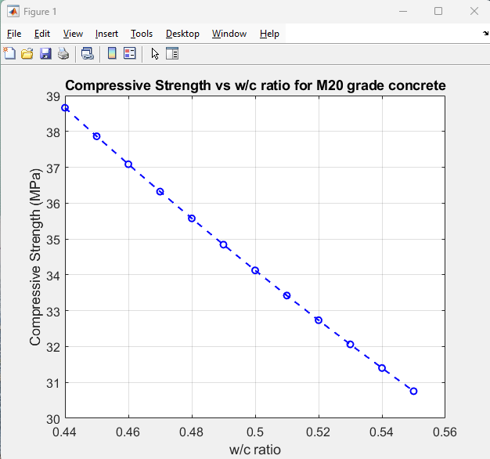
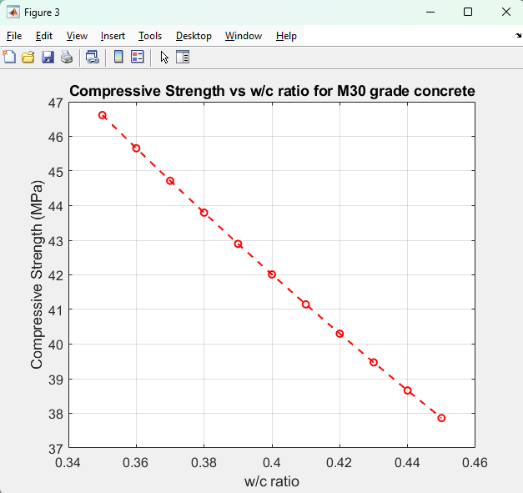
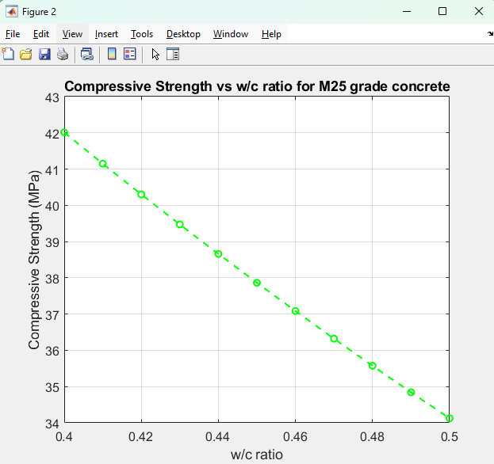
04
RESULTS
Concrete grades M20, M25, and M30 show an inverse relationship between compressive strength and w/c ratio, aligning with Abrams’ law. Indian standards limit maximum w/c ratios to 0.55 (M20), 0.50 (M25), and 0.45 (M30) for strength and durability. Optimization techniques, like Genetic Algorithms, enhance mix designs for high-quality, sustainable concrete
Figure 1 . Compressive Strength vs w/c ratio for M20 grade concrete
Figure 3 . Compressive Strength vs w/c ratio for M30 grade concrete
Figure 2 . Variation of Compressive Strength with w/c ratio for M25 grade concrete

Slide 10
Item Details | Quantites obtained through Mix design using GA | Quantites obtained through Mix design due manually
Cement (kg/m3) | 315.4 | 350
Water (kg/m3 | 157.72 | 175
Fine aggregate (kg/m3) | 729.4 | 609.91
Coarse aggregate (kg/m3) | 1217.6 | 1188.95
Chemical admixture (kg) | 3.78 | 4.1
Workability | Medium | Medium
Strength (MPa) | 34.125 | 33.5
Table 2 . Comparison of mix obtained in GA with mix designed
manually for M20 grade concrete with w/c ratio of 0.55
Item Details | Quantites obtained through Mix design using GA | Quantites obtained through Mix design due manually
Cement (kg/m3) | 300 | 320
Water (kg/m3 | 157.72 | 176
Fine aggregate (kg/m3) | 753.72 | 559.83
Coarse aggregate (kg/m3) | 1206.1 | 1132.5
Chemical admixture (kg) | 3.6 | 3.7
Workability | Medium | Medium
Strength (MPa) | 30.75 | 28
Table 1 . Comparison of mix obtained in GA with
mix designed manually for M20 grade concrete with w/c ratio of 0.5

Slide 11
Item Details | Quantites obtained through Mix design using GA | Quantites obtained through Mix design due manually
Cement (kg/m3) | 350.5 | 380
Water (kg/m3 | 157.72 | 171
Fine aggregate (kg/m3) | 676.8 | 646
Coarse aggregate (kg/m3) | 1215.5 | 1238.8
Chemical admixture (kg) | 4.2 | 4.5
Workability | Medium | Medium
Strength (MPa) | 38.25 | 33.4
Table 4 . Comparison of mix obtained in GA with
mix designed manually for M25 grade concrete with w/c ratio of 0.48
Item Details | Quantites obtained through Mix design using GA | Quantites obtained through Mix design due manually
Cement (kg/m3) | 328.6 | 360
Water (kg/m3 | 157.72 | 172.5
Fine aggregate (kg/m3) | 717.64 | 723.7
Coarse aggregate (kg/m3) | 1218.47 | 723.7
Chemical admixture (kg) | 2.4 | 2.5
Workability | Medium | Medium
Strength (MPa) | 35.57 | 34.62
Table 3 . Comparison of mix obtained in GA with
mix designed manually for M25 grade concrete with w/c ratio of 0.45

Slide 12
Item Details | Quantites obtained through Mix design using GA | Quantites obtained through Mix design due manually
Cement (kg/m3) | 384.7 | 420
Water (kg/m3 | 157.72 | 172.2
Fine aggregate (kg/m3) | 671.9 | 649.3
Coarse aggregate (kg/m3) | 1211.6 | 1238.4
Chemical admixture (kg) | 4.6 | 4.5
Workability | Medium | Medium
Strength (MPa) | 41.14 | 39.36
Table 6 . Comparison of mix obtained in GA with
mix designed manually for M30 grade concrete with w/c ratio of 0.42
Item Details | Quantites obtained through Mix design using GA | Quantites obtained through Mix design due manually
Cement (kg/m3) | 375.5 | 400
Water (kg/m3 | 157.72 | 168
Fine aggregate (kg/m3) | 678.55 | 644
Coarse aggregate (kg/m3) | 1213 | 1232
Chemical admixture (kg) | 4.5 | 4.8
Workability | Medium | Medium
Strength (MPa) | 40.3 | 40.2
Table 5 . Comparison of mix obtained in GA with mix
designed manually for M30 grade concrete with w/c ratio of 0.41

Slide 13
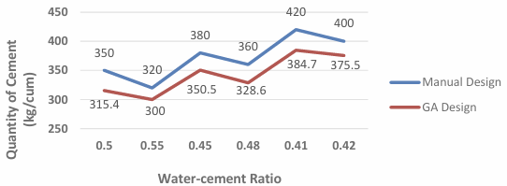
Cement is the most expensive ingredient in concrete and its scarcity impacts mix design.
Using Genetic Algorithms (MATLAB) for mix design significantly reduces cement quantities compared to manual methods,
as shown in Figure 4, optimizing cost and resource use.
Grade of Concrete | W/C Ratio | Percentage reduction in cement quality using GA (%)
M20 | 0.5 | 9.9
 | 0.55 | 6.3
M25 | 0.45 | 7.8
 | 0.48 | 8.7
M30 | 0.41 | 8.4
 | 0.42 | 6.1
Figure 4. Quantity of Cement for various mix design cases
Table 7. Percentage reduction in cement quantities
using GA technique in comparison to manual method

Slide 14






CONCLUSIONS
1.MATLAB implementation with Genetic Algorithm (GA) provides an efficient, fast, and optimized approach to concrete mix design, outperforming manual methods
5. The methodology highlights a scalable and efficient design process for high-performance concrete mixes
2. GA-optimized mix design offers significant cost savings and environmental benefits. Optimized mixes achievethe desired strength with reduced cement content.
4. Genetic Algorithm (GA) optimization offers better results compared to manual design approaches.
3. Future scope includes analyzing concrete properties like durability and workability for optimized mixes.
05

Slide 15
REFERENCES
[1] Murthy, D.Zealakshmi & Ravichandran, A. & Kothandaraman, S.. (2013). Computer Aided High Strength Concrete Mixture Proportion using Mat Lab. International Journal of Computer Applications. 70. 18-25. 10.5120/11982-7857.
[2] W.Park. Genetic Algorithm based mix proportion design method for Recycled Aggregate Concrete,Trans. Can. Soc. Mech,Eng., vol 37, no. 3, pp.345-354,2013.
[3] M, Thejas & J, Manjunath & L, Shruthi. (2017). Optimization of mix design of self-compacting concrete using matlab. International Journal of Research in Engineering and Technology. 06. 20-26. 10.15623/ijret.2017.0617004.
[4] Makenya A. R., John Paul M., Potentiality of Using a Developed MatLab Program for the Design of High Strength Concrete Mixes, Journal of Civil Engineering Research, Vol. 7 No. 3, 2017, pp. 81-98. doi: 10.5923/j.jce.20170703.01.
[5] Erntroy, H. C. and Shacklock, B. W., 1954. Design of High-strength Concrete Mixes. s.l.:Cement and Concrete Association.
06

Slide 16

THANK YOU

